Slide 1
WWW/HTML Basics
CS 4173

Slide 2
What is the WWW?
A distributed document delivery system
Uses a client-server model
Main presentation language is HTML

Slide 3
Client-Server Model
Two processes (possibly networked):
  The client
    Sends requests to the server
    Blocks until reply is received
  The server
    Processes requests from clients
    Never blocks
    Can reply to several clients simultaneously

Slide 4
HTML
Hypertext Markup Language
Intended to be maximally portable
  Logical markup
  Graceful degradation of presentation
An ideal promoted by early WWW
  Used to be more honoured in the breach
  Is it getting better now?

Slide 5
Markup Languages
Markup:
  Embedded codes in documents
  Codes are called `tags’
  Codes
    Describe the structure documents
    Include instructions for processing
Markup language:
  Computer language for describing syntax of tags
  May be used with other tools to specify rendering

Slide 6
Logical Markup
Logical markup:
  Describes parts of document
  Does not specify how to render
Example:
  This is <strong>very</strong> important
  This is very important

Slide 7
Logical Markup
Presentation is client’s `decision’
When client cannot present then there is graceful degradation
  <img alt=“image description”
  src=“foo.gif”>
  Object example from Cougar

Slide 8
Some history
Gopher & the Internet Superhighway
SGML
  GML + Charles Goldfarb = SGML
  eXtensible Markup Language
HTML
XML and XHTML

Slide 9
Why HTML became XHTML
HTML was originally a SGML application
  Tags described the syntax
  A DTD could check the syntax
  Informal mapping from syntax to rendering
Multiple incompatible versions arose
  IETF moves at ’net speed not web $peed
  Tag abuse was rampant in the ’net
  They were a plague unto the users

Slide 10
Why HTML became XHTML (2)
If you think IMG is bad …
Big vendors (M$ and N$ mostly) agreed
  To start over
  To use eXtensible Markup Language
    A re-write of SGML emphasizing simplicity
    Carefully planned by CS savvy folks
    Includes hooks for future development

Slide 11
XHTML Basics
Very few real changes from HTML
But more strict
All tags are in lowercase
All tags must be closed
  Empty tags
  Paired tags

Slide 12
XHTML Basics
3 Parts to an XHTML or HTML document
  DOCTYPE
    What DTD are you using
  Head
    Meta information
    Only <title> is required
  Body
    Text to render

Slide 13
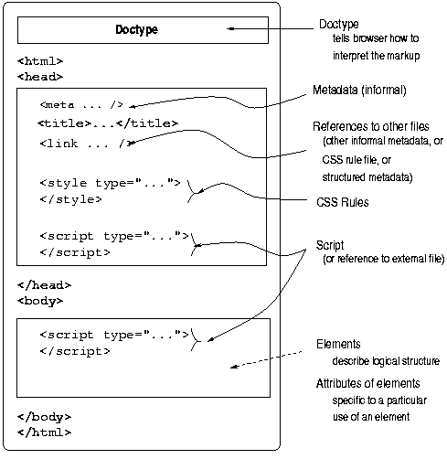
XHTML Document Structure

Slide 14
XHTML Basics
Tags
  Elements
  Attributes
Entities
  <,>,&,‘ ’
  Ö,ð,÷,©, etc.
  See example at CS4173 website
Comments
Notes:
‘ ’s is &nbsp; (the non-breaking space)

Slide 15
XHTML Tags vs. Elements
Tag is markup to represent an element
Logical vs. Presentation Elements
  TT ≈ CODE, KBD, PRE?
  B/IT/U ≈ EM/STRONG
Lists
  UL/OL
  DL

Slide 16
XHTML Tags vs. Elements
Block-level and in-line elements
  TABLE, P, BLOCKQUOTE, DIV, etc.
  CODE, Q, H1, SPAN, etc.
Grouping Elements
  DIV
  SPAN
One-part elements
  BR, etc.

Slide 17
XHTML Tags vs. Elements
Browser-specific tags
  MARQUEE, BLINK, etc.
What happens when a browser doesn't recognize a tag?

Slide 18
XHTML Basics
Tags may be nested but
Tags may not overlap

Slide 19
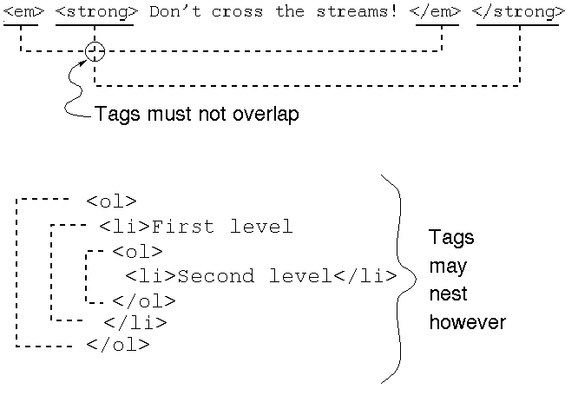
Overlap versus Nesting

Slide 20
Links — Why The WWW Is HT
‘A’ element
  HREF
  NAME
  CLASS
  REL
  TYPE
URIs and URLs
RFCs
  TITLE
  ID
  STYLE
  Anchor Text
  TABINDEX

Slide 21
Where are the tools?
HTML Tidy
  /opt/bin/tidy on borg
The validator
  http://validator.w3.org/
  http://www.cs.dal.ca/validator?
  http://www.cs.dal.ca/validate?
  http://www.cs.dal.ca:81?

Slide 22
XHTML/HTML Examples
XHTML element sampler
XHTML sample template
  Both in the examples section of the website

Slide 23
For More About HTML
RFC 1866 (HTML 2.0) (at faqs.org)
  Explains some of the philosophy behind HTML
HTML 4.01 (at W3C)
  Last version of HTML
XHTML 1.1 (at W3C)
  Modularized XHTML
  So many choices!…

Slide 24
Which Standard to Follow?
Minimal standard for this course is HTML 4.01 Transitional
Preferred standard is XHTML 1.0 or 1.1
See Picking a Rendering Mode
  By Eric Meyer
  In the Readings part of the Resources

Slide 25
Here endeth the lesson

